Slide 1
Why Python or a Brief History of Computer Languages.

Slide 2
How Does a Programming Language Work

Slide 3
How Does a Computer Work?

Slide 4


Von Neumann Architecture
Computer
Control Unit
Ok, but how is this executed exactly?
Central Processing Unit (CPU)
Clock
Input Device
Output Device
Arithmetic/Logic Unit
Memory

Slide 5
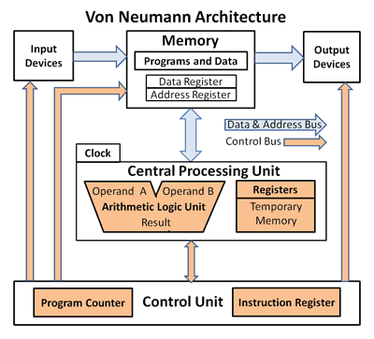

Slide 6
The Pioneers (Pre-Vacuume Tube Age ~1800s - 1907)

Slide 7
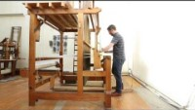
1804 – Joseph Marie Jacquard
The Jacquard loom
Used Punch Cards system to recreate complex patterns on a loom.

Slide 8
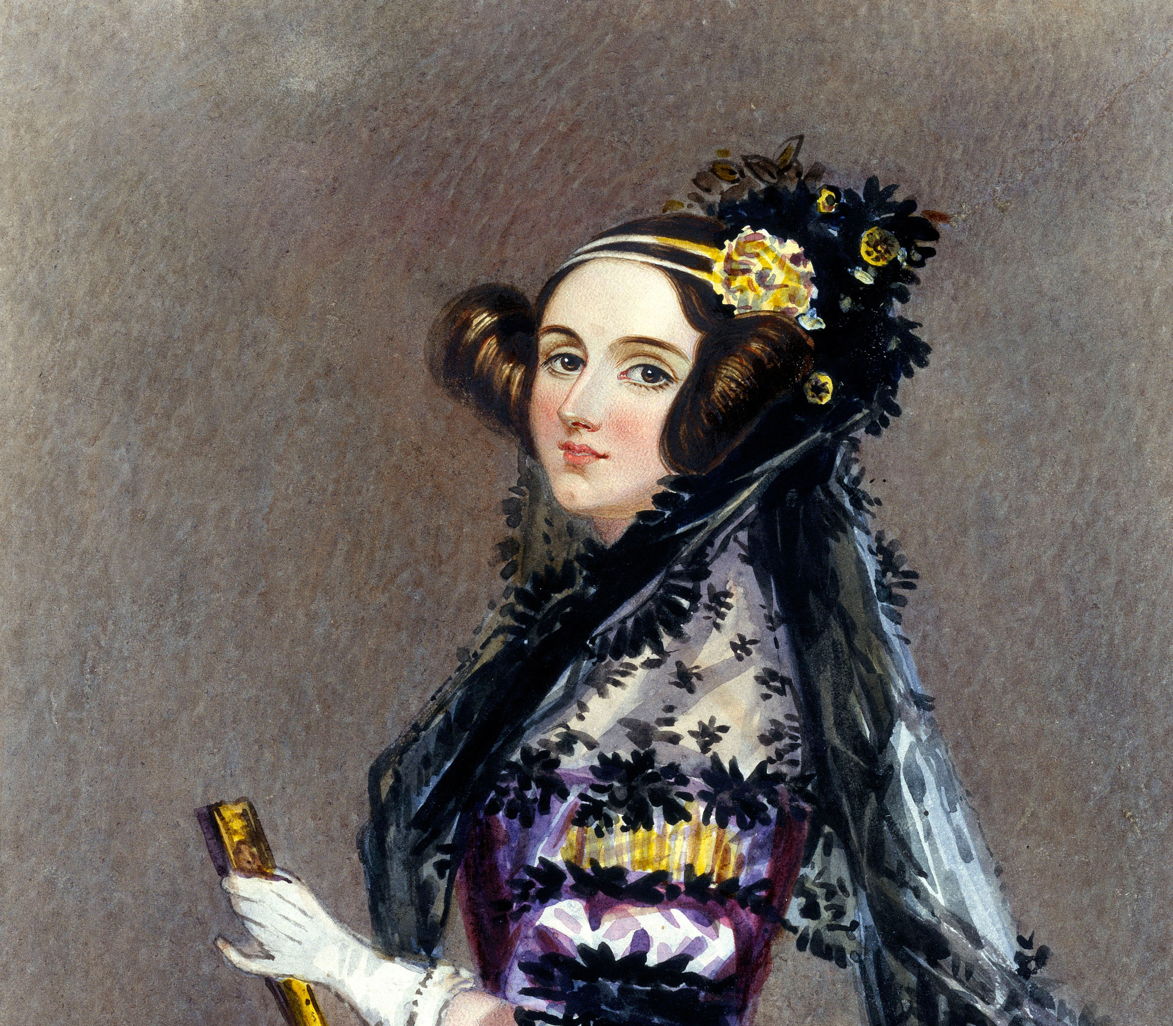
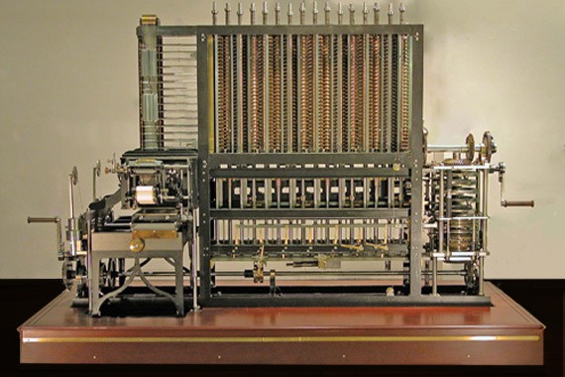
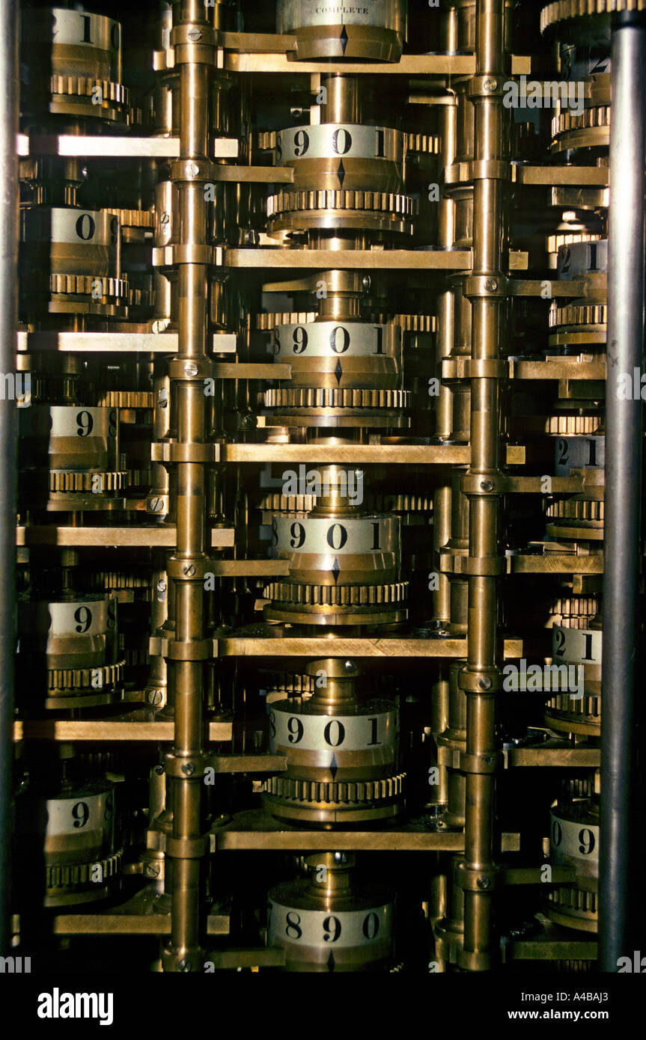
1883 – Ada Lovelace
First Programming Language to Calculate Bernoulli numbers
Created for a Victorian Steam Powered Calculator
A Primitive Computer

Slide 9
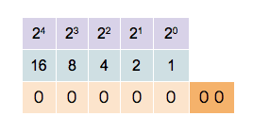
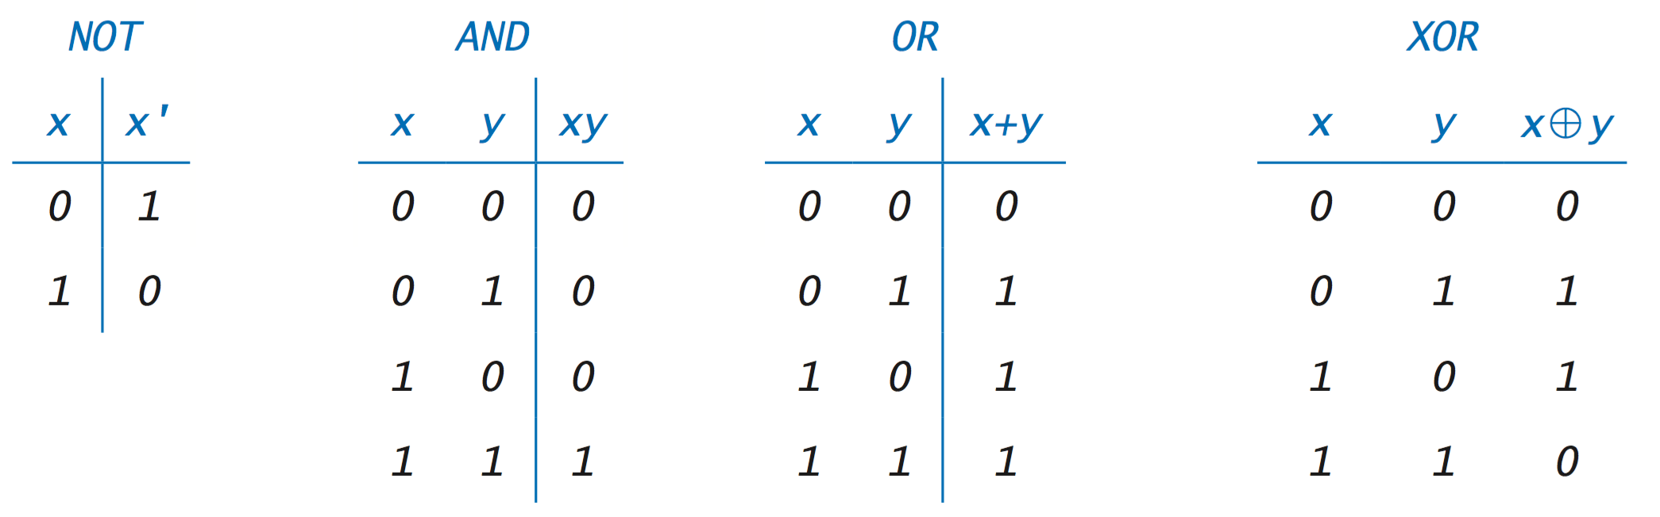
1886 – Boolean Logic & Logic Gates
In mathematics, a Boolean function is a function whose arguments and result assume values from a two-element set (usually {true, false}, {0,1} or {-1,1})

Slide 10
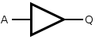
1886 – Boolean Logic & Logic Gates
Buffer Gate
INPUT | OUTPUT
A | Q
0 | 0
1 | 1

Slide 11
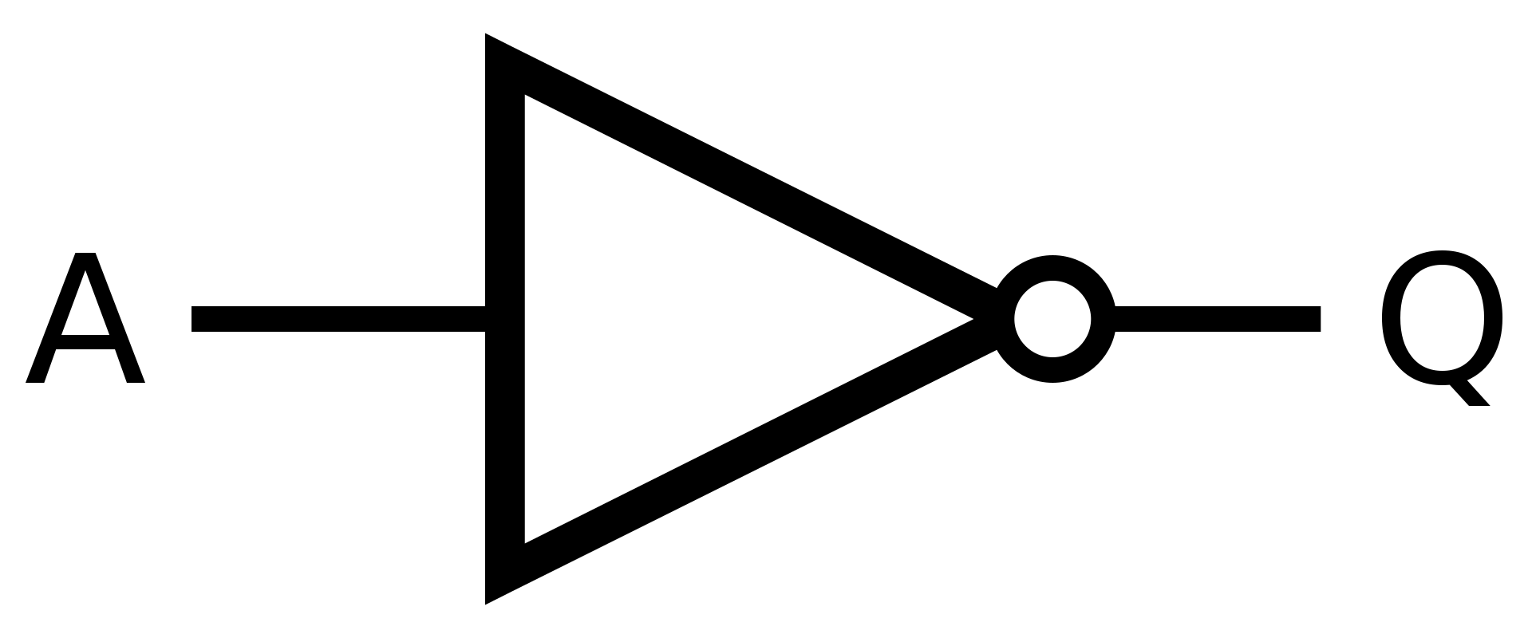
1886 – Boolean Logic & Logic Gates
Inverter Gate
INPUT | OUTPUT
A | Q
0 | 1
1 | 0

Slide 12
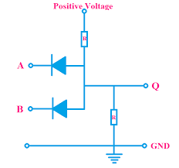
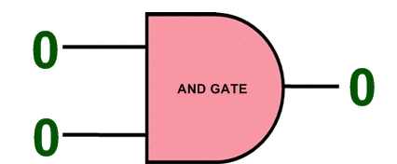
1886 – Boolean Logic & Logic Gates
AND Gate
INPUT |  | OUTPUT
A | B | Q
0 | 0 | 0
0 | 1 | 0
1 | 0 | 0
1 | 1 | 1

Slide 13

1886 – Boolean Logic & Logic Gates
XOR Gate
INPUT |  | OUTPUT
A | B | Q
0 | 0 | 0
0 | 1 | 1
1 | 0 | 1
1 | 1 | 0

Slide 14
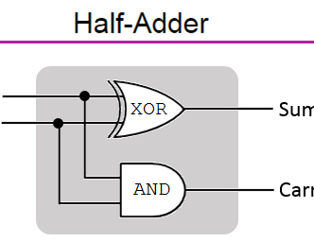
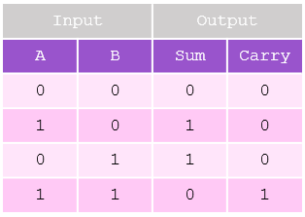
1886 – Boolean Logic & Logic Gates

Slide 15
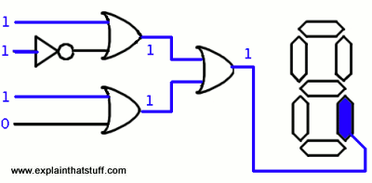
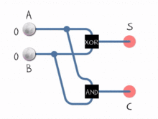
1886 – Boolean Logic & Logic Gates

Slide 16
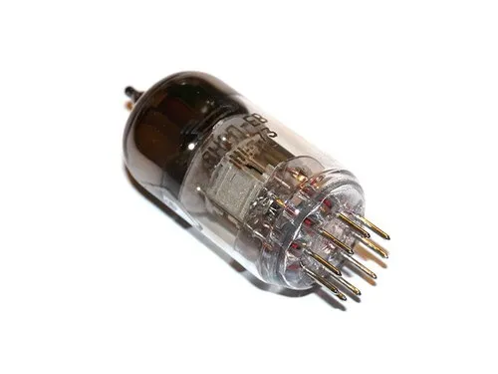
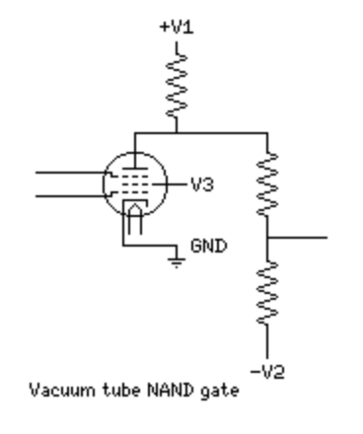
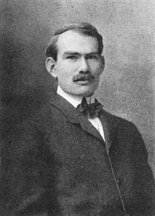
1907 – Vacuume Tubes
Lee de Forest Created the first electronic gates using Vacuum Tubes
The main advantage of using vacuum tube technology:
Speed of Electron is greater than any mechanical based calculator
The Vacuum environment is not susceptible to electro-magnetic interference
A
B
O

Slide 17
The Monsters (Pre-Transistor Age -1907s ~ 1950)

Slide 18
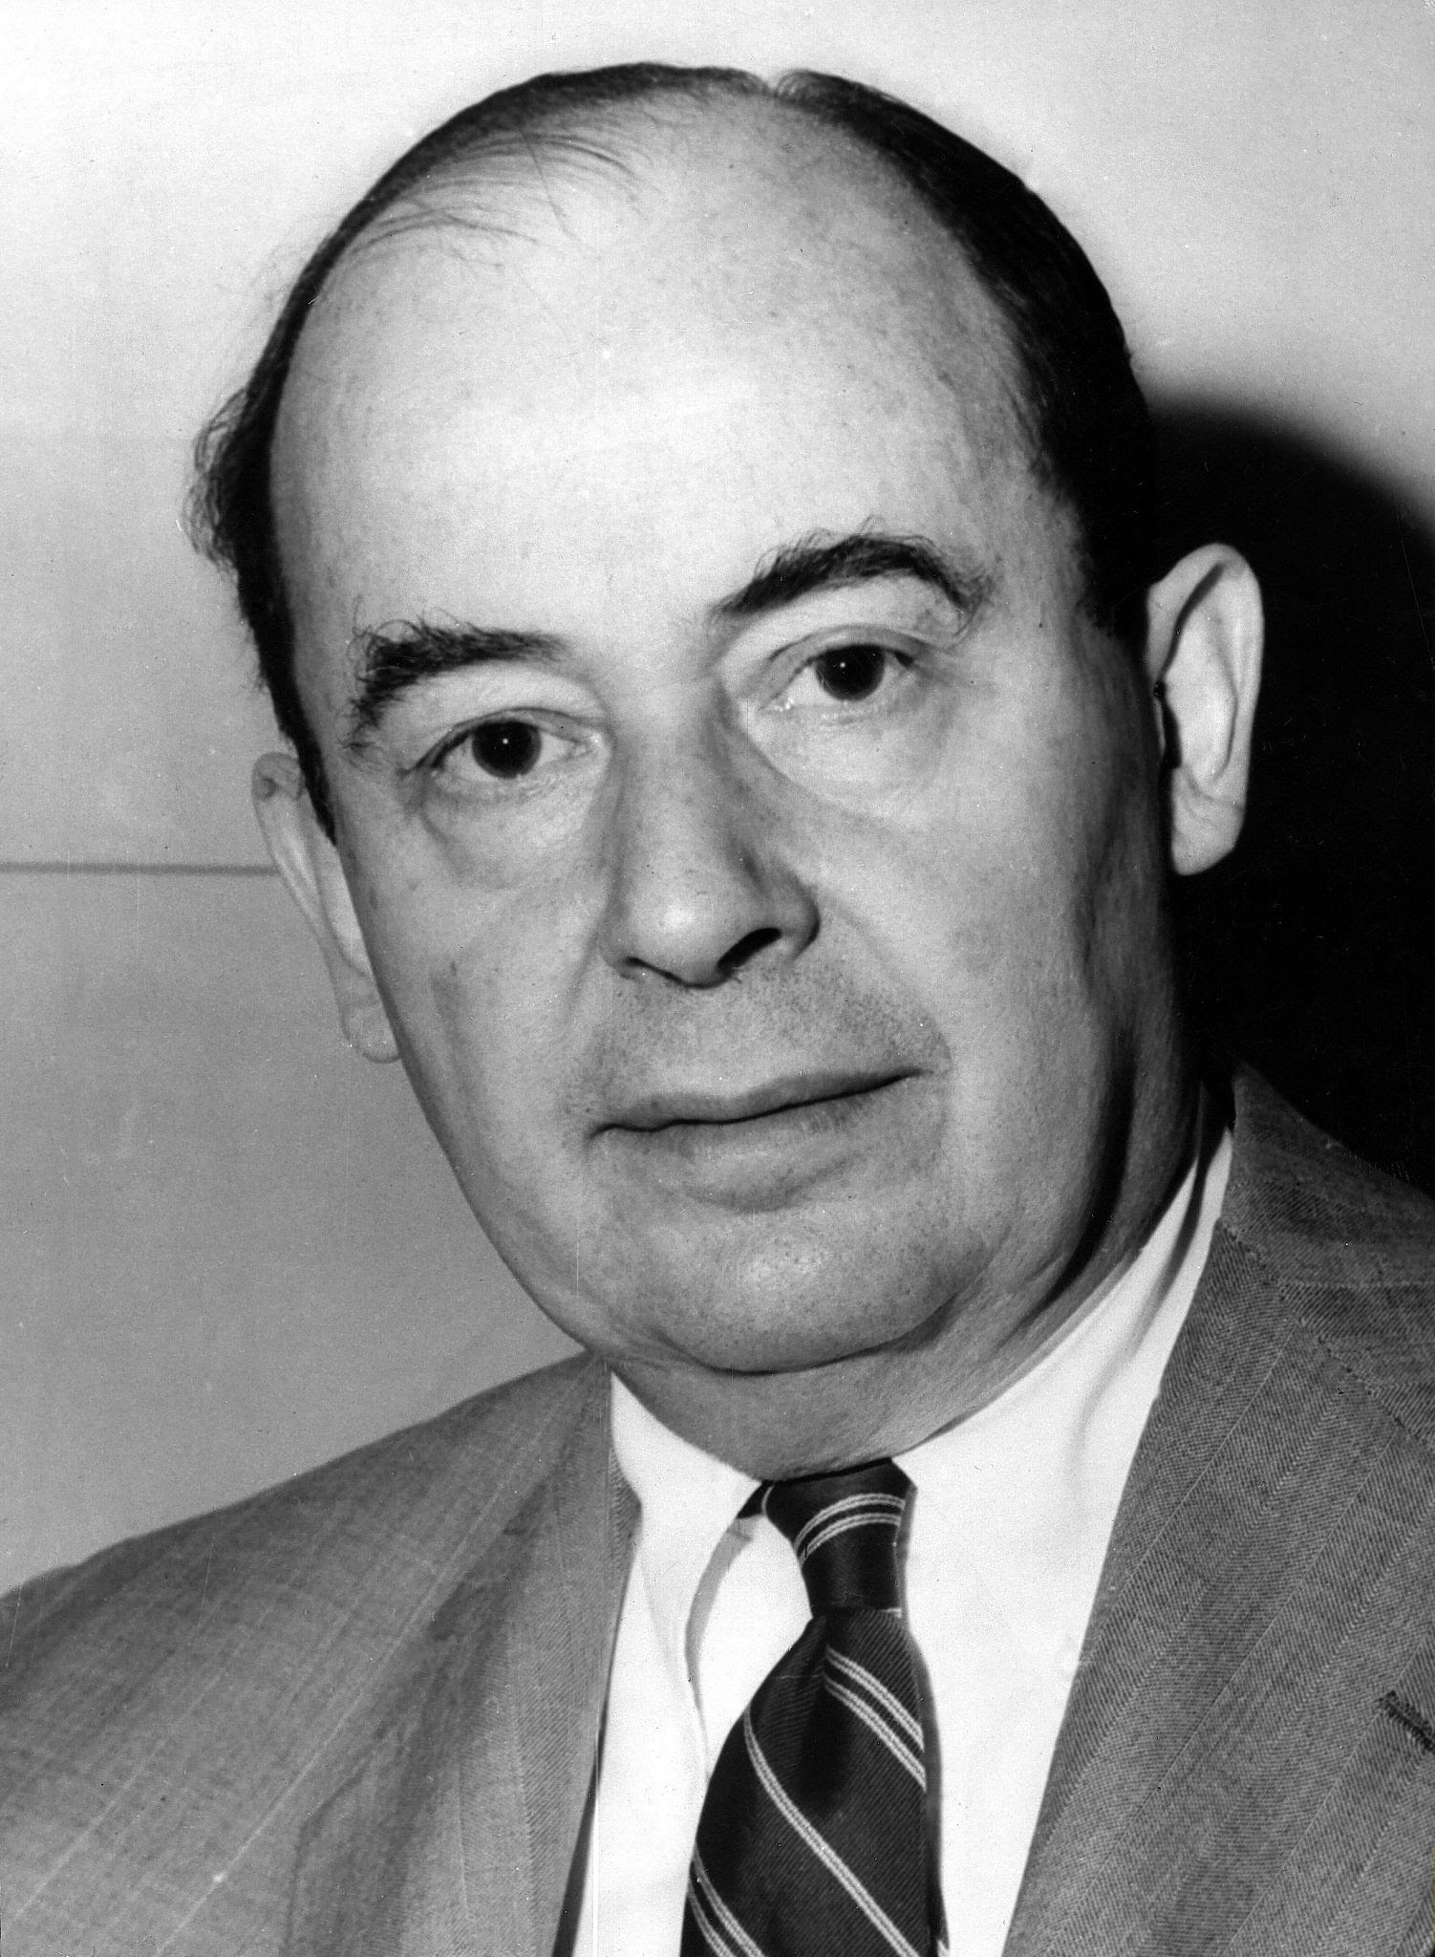
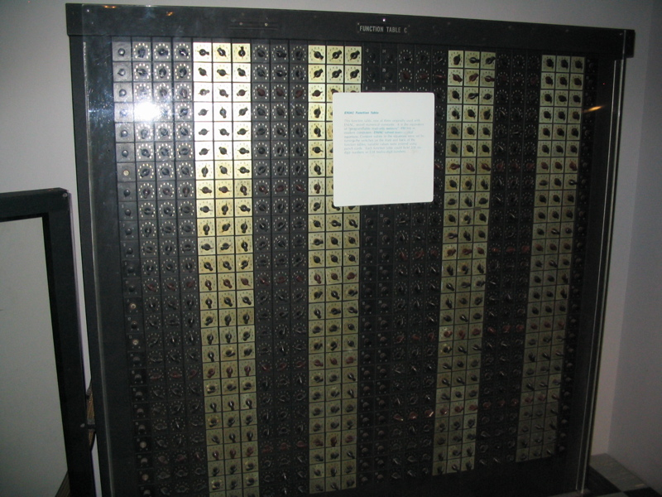
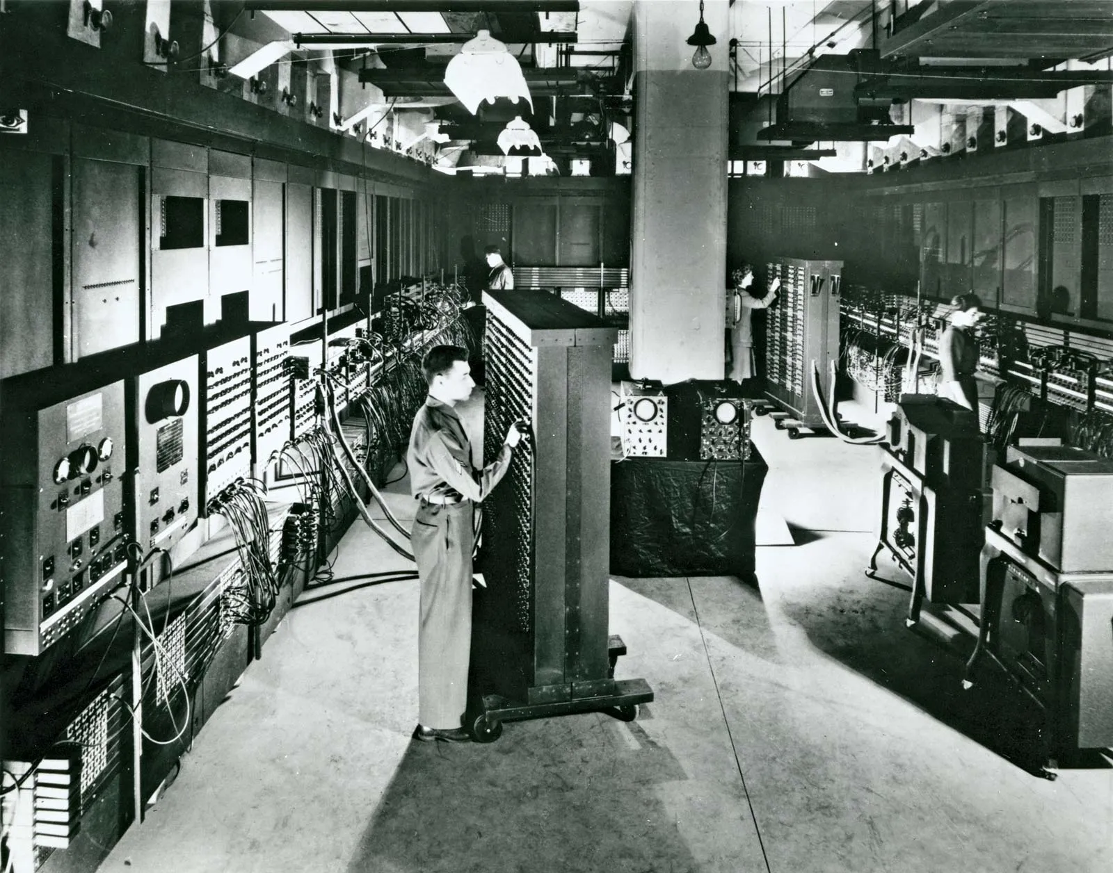
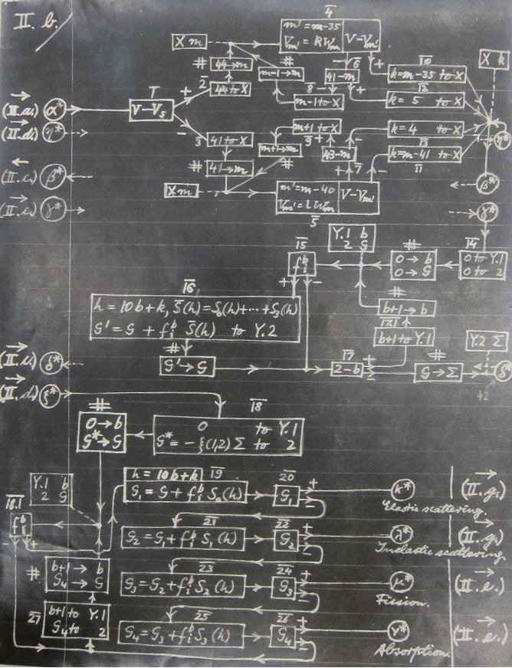
1943 – ENIAC coding system
John Von Neumann Described the first computer memory.
Computers Would Use binary notation
Computers would be fed instructions which would be stored in memory and then execute those instructions. Instructions can come in Magnetic Tapes, Punch Cards or other external memory devices.
EINAC Function Table Used to feed the machine instructions

Slide 19
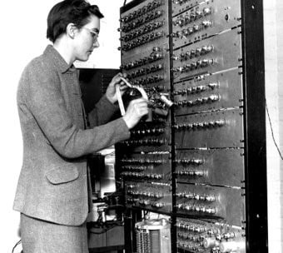
1947 – ARC/Birkbeck Assembler
Kathleen Booth invented the first assembly language (Machine Code)
It’s primary purpose was to move commands from one register to another .
This allows for the creation of subroutines.
Used with Punch Cards

Slide 20
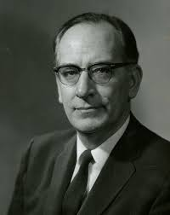
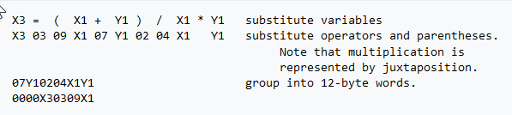
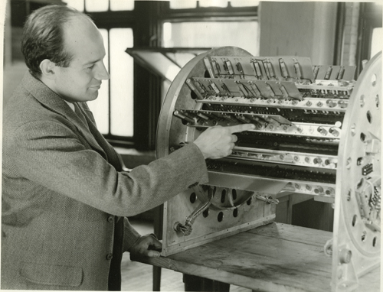
1949 – Short Code
John Mauchly created one of the first interpreted languages
Comands can be writen in plain mathematical expressions and then translated to machine code
Was 50 times slower than machine code

Slide 21
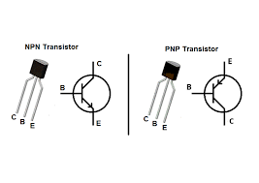
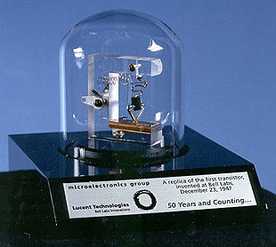
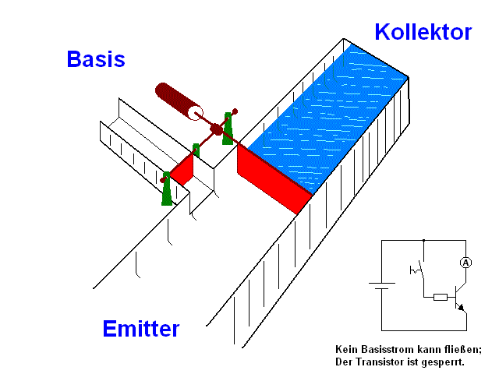
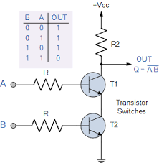
~1950 – Transistors
The main issue with vacuum tubes is that they have a very short use-life & consume a lot fo electricity
Transistors don’t need a vacuum to operate in, are much smaller and much more energy efficient.
This allows to make things much smaller

Slide 22
Higher Level Languages (1950s ~ 1990)

Slide 23
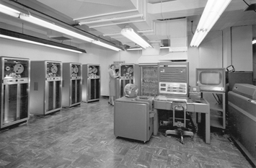
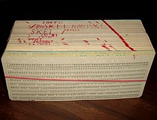
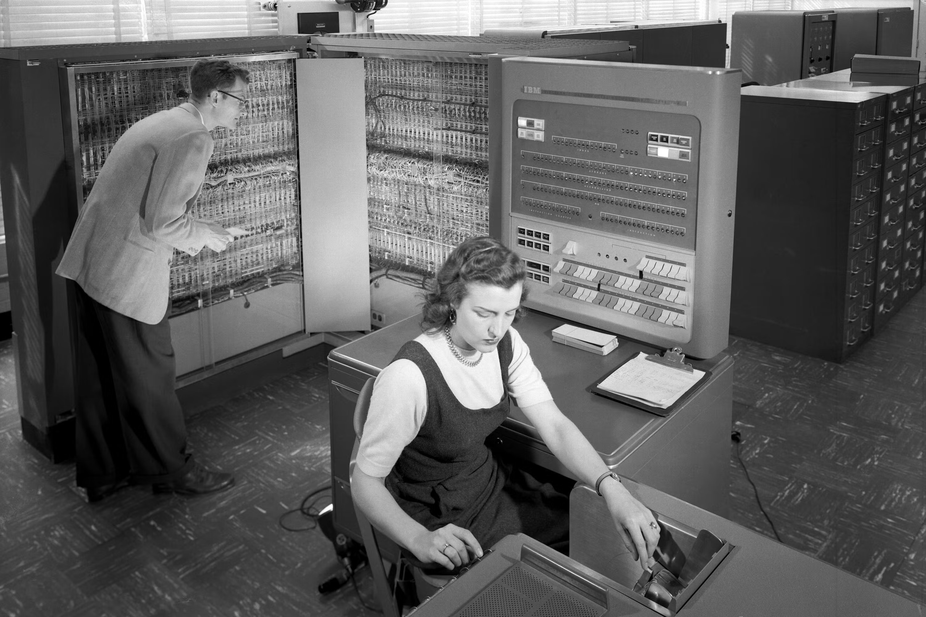
1954 – Fortran
Developed by IBM
First use of statements IF, GOTO, etc to manipulate switches and create sub routines.
Still running today

Slide 24
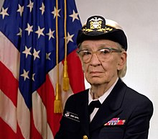
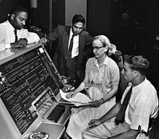
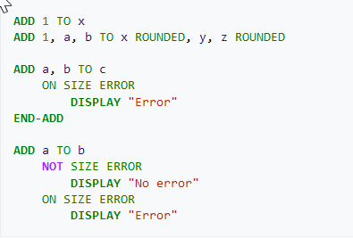
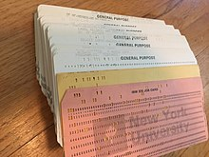
1959 – COBOL
Developed by Grace Hopper
Common Business Oriented Language
Used English Syntax
Still Used today in most ATMs.

Slide 25
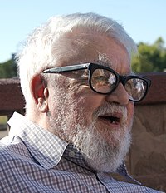
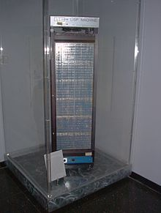
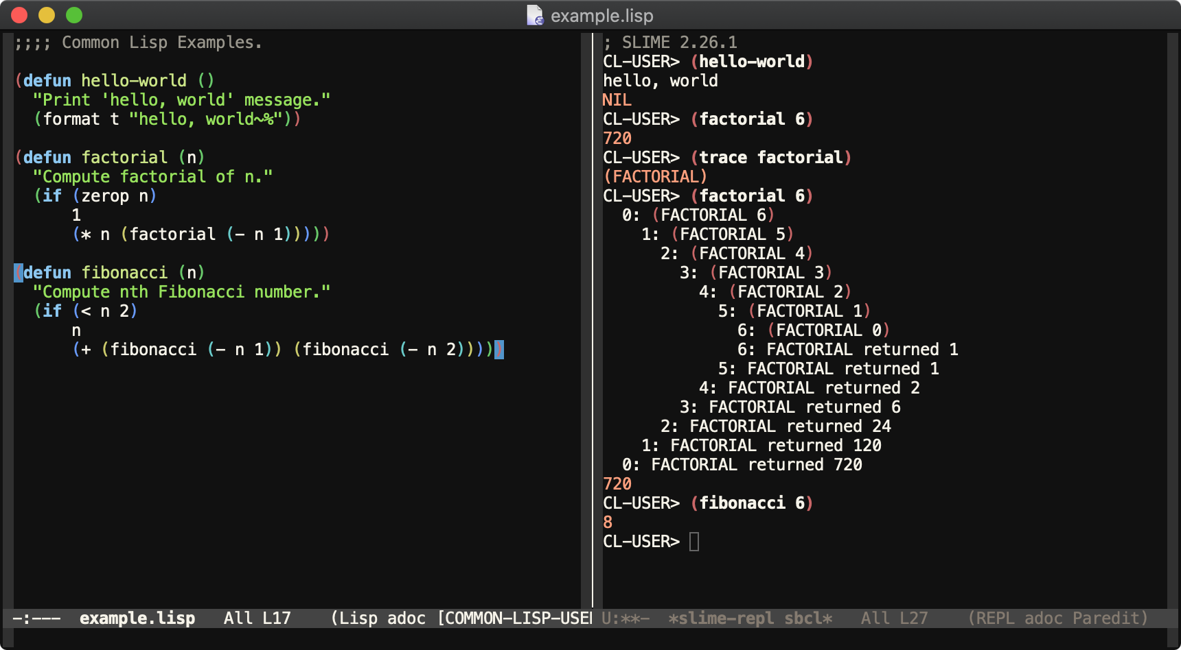
1959 – Lisp
Developed by John McCarthy
Introduced List-processing and Recusion
Still used by Boeing

Slide 26
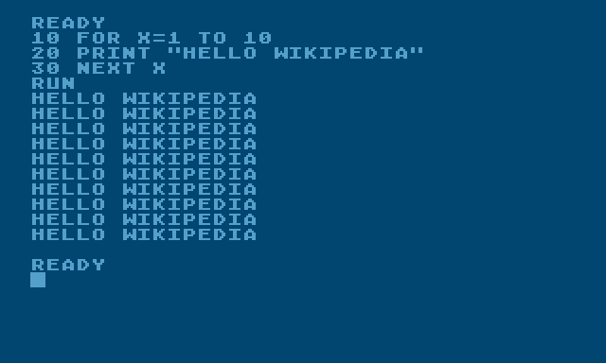
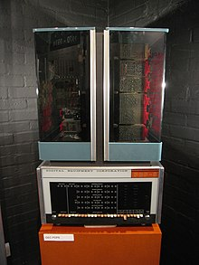
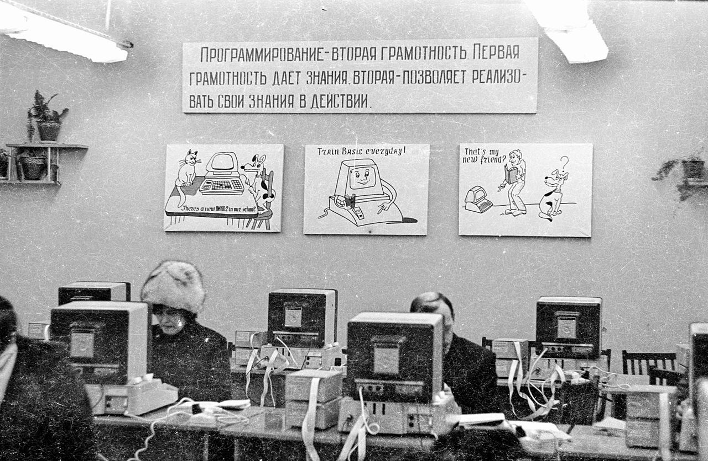
1964 – BASIC
Developed by Dartmouth College
Beginners All-Purpose Symbolic Instruction Code
For people to use without the need for complex mathematical knowledge
Popular foor mini-computer use

Slide 27
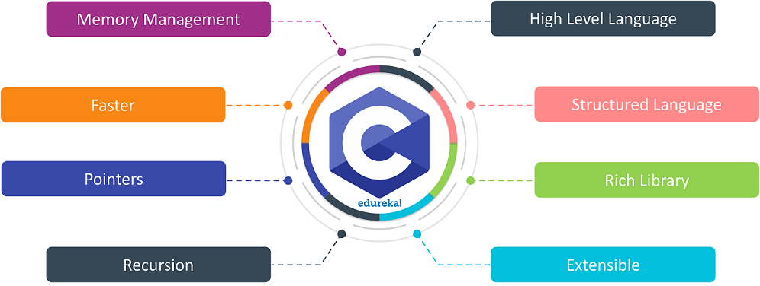
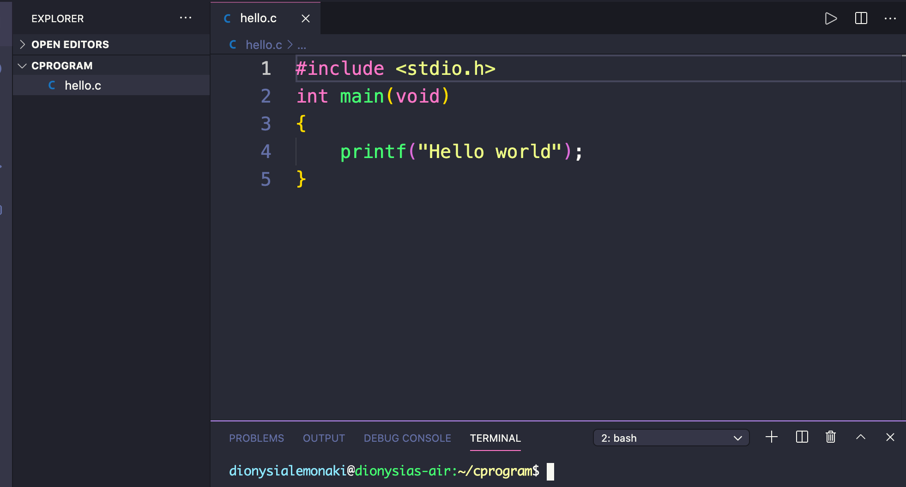
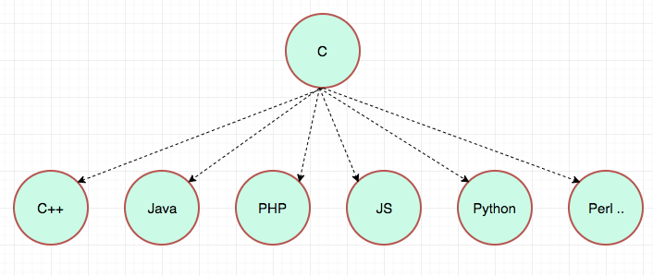
1972 – C
Developed by Denis Ritchie
For the Unix Operating system
Father of almost all Contemporary Languages
Still widely used

Slide 28

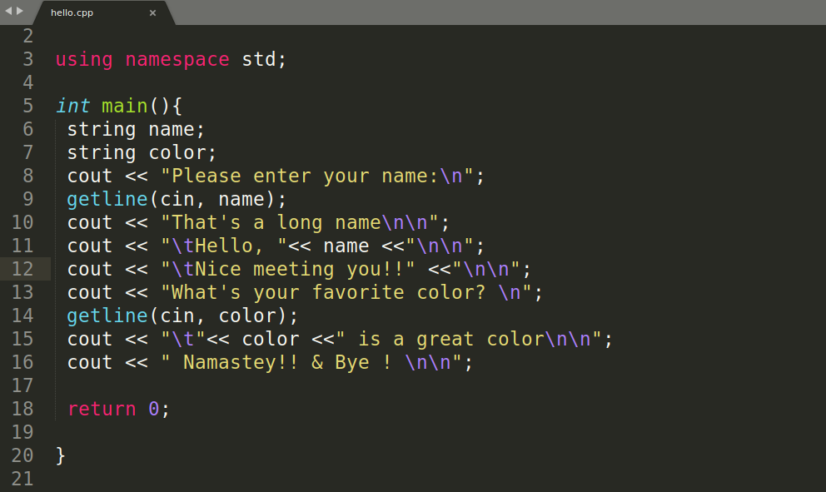
1983 – C++
Developed by Bjarne Stroustrup in Aarus University!
An extension of C providing OOP principles
One of the most used languages

Slide 29


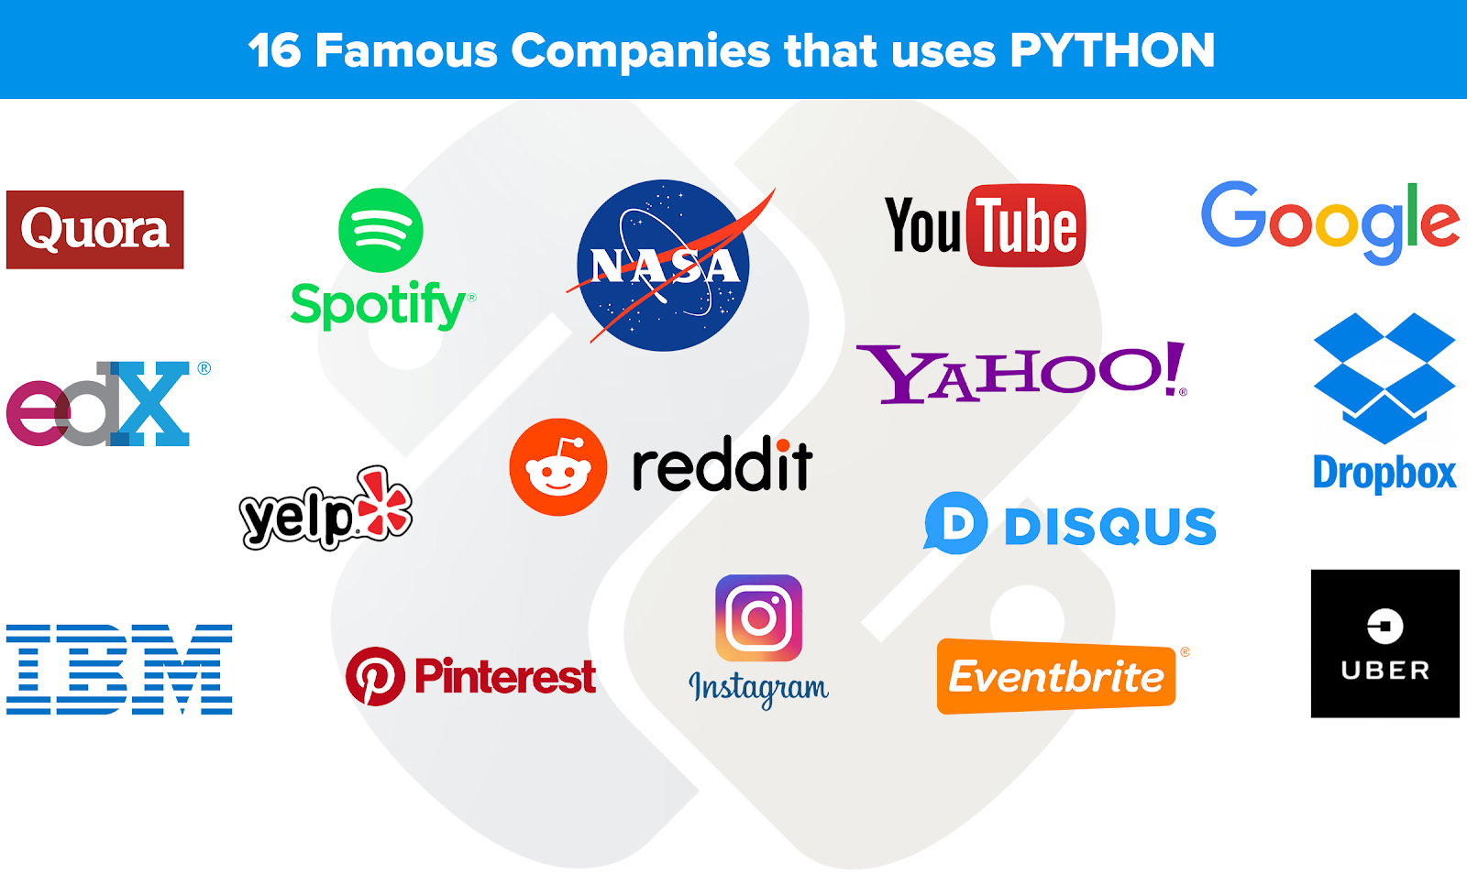
1991 – Python
Named after Monthy Python
Developed by Duch CS Guido Van Rossum.
Minimalist User Syntax
One of the most popular computer languages

Slide 30
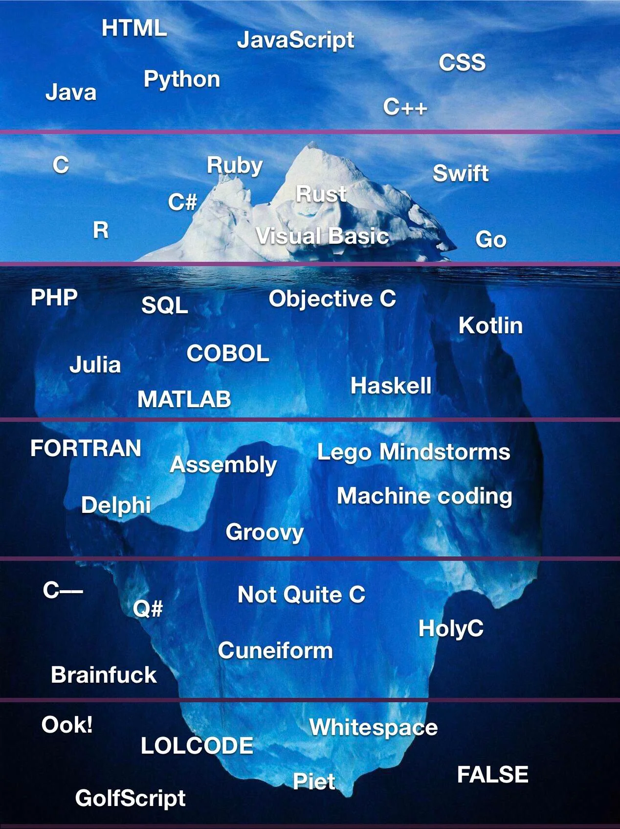
And Many More

Slide 31
Check out the Still (light blue) bullets
These Still colored (light blue) bullets replace the Highlight bullets
These bullets now pass the accessibility requirements per our Brand Guidelines

Slide 32
This slide no longer contains our highlight color
This color has been changed to still (light blue)
These Still colored (light blue) bullets replace the Highlight bullets
These bullets now pass the accessibility requirements per our Brand Guidelines

Slide 35

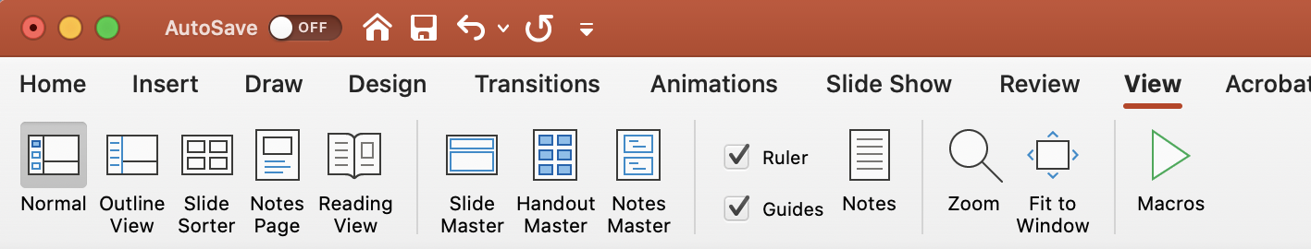
Margins and footers
Ensure footers are relevant and consistent. Always include a footer.
Stay within the margins. Find the margins in the View menu and click on Guides.

Slide 36
Example of graphs

Slide 37
Example of graphs

Slide 38
Example of chart
Head
Section A
Section B
Section C
1
2
3
1
2
3
1
2
3

Slide 39






























Popular icons — view full library for more
360°
Consolidate
Award
Barcode
Brain
Briefcase
Governance
Data
Delivery
Digital Transformation
New Document
Employee
Personalization
Gear
Handshake
Analyze
Hierarchy
Location
Messages
Customer
Dashboard
Server
Retail
Shopping Cart
Handcart
Arrows
Tag
Bullseye
Thumbs Up
Warehouse

Slide 40












Product icons — view full library for more

Slide 41



Images, icons and WoT slides
Asset library
Follow the link to access the icon library
Follow the link to access the image library
Follow the link to access the Window of Transparency slides

Slide 42
Textboxes and arrows
Toolbox
XX%
Text explaining the impressive number. We can get into some details!
A box with fill
use with less text
Detailed box
With a 14 point size we can write a lot but take care in visual presentations as this will derail your audience and they will read on instead of listening.
White box – works well for placement on a colored background
Orange border
Blue border
Background Grey

